Slide 1

CHAPTER 7
PROPERTIES OF FUNCTIONS
Copyright © Cengage Learning. All rights reserved.

Slide 2

7.2
One-to-One, Onto, and Inverse Functions
Copyright © Cengage Learning. All rights reserved.

Slide 3
One-to-One, Onto, and Inverse Functions
In this section we discuss two important properties that functions may satisfy: the property of being one-to-one and the property of being onto.
Functions that satisfy both properties are called one-to-one correspondences or one-to-one onto functions.
When a function is a one-to-one correspondence, the elements of its domain and co-domain match up perfectly, and we can define an inverse function from the co-domain to the domain that “undoes” the action of the function.

Slide 4
One-to-One Functions

Slide 5
One-to-One Functions
In terms of arrow diagrams, this means that two or more arrows that start in the domain can point to the same element in the co-domain.
On the other hand, if no two arrows that start in the domain point to the same element of the co-domain then the function is called one-to-one or injective.
For a one-to-one function, each element of the co-domain is the image of at most one element of the domain.

Slide 6
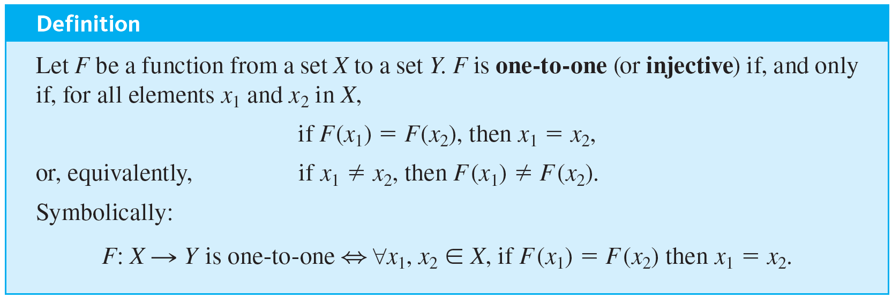
One-to-One Functions
To obtain a precise statement of what it means for a function not to be one-to-one, take the negation of one of the equivalent versions of the definition above.

Slide 7

One-to-One Functions
Thus:
In other words, if elements x₁ and x₂ can be found that have the same function value but are not equal, then F is not one-to-one.
In terms of arrow diagrams, a one-to-one function can be thought of as a function that separates points. That is, it takes distinct points of the domain to distinct points of the codomain.

Slide 8
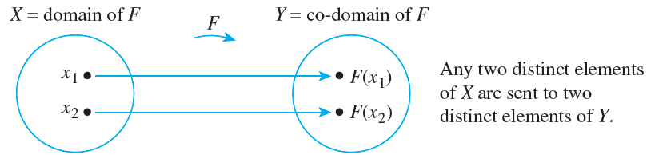
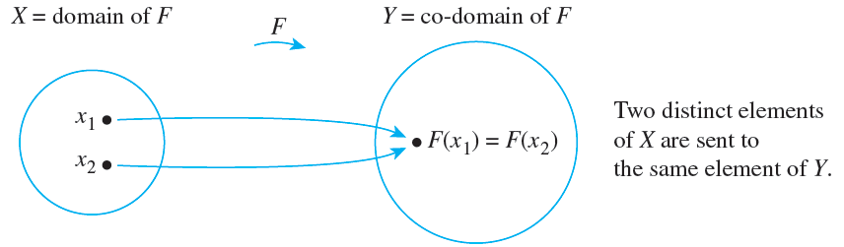
One-to-One Functions
A function that is not one-to-one fails to separate points. In other words, at least two points of the domain are taken to the same point of the co-domain. This distinction is illustrated in Figures 7.2.1(a) and 7.2.1(b).
A One-to-One Function Separates Points
A Function That Is Not One-to-One Collapses Points Together
Figures 7.2.1(a)
Figures 7.2.1(b)

Slide 9
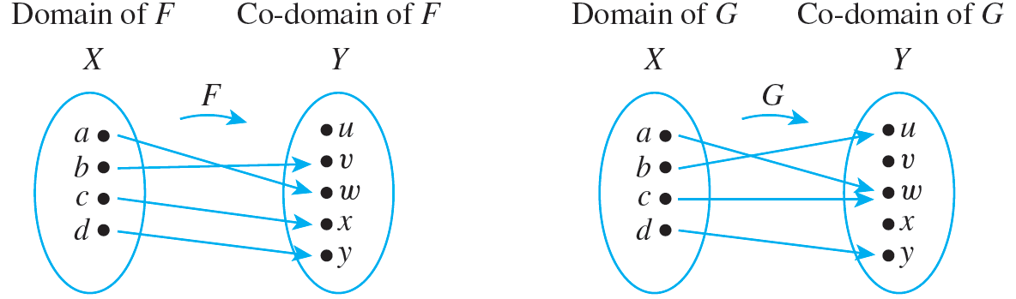
Example 7.2.1 – Identifying One-to-One Functions Defined on Finite Sets
a. Do either of the arrow diagrams in Figure 7.2.2 define one-to-one functions?
Figures 7.2.2

Slide 10
Example 7.2.1 – Identifying One-to-One Functions Defined on Finite Sets
continued
b. Let X = {1, 2, 3} and Y = {a, b, c, d}. Define H: X → Y as follows: H(1) = c, H(2) = a, and H(3) = d.
Define K: X → Y as follows: K(1) = d, K(2) = b, and K(3) = d. Is either H or K one-to-one?

Slide 11
Example 7.2.1 – Solution
a. F is one-to-one but G is not. F is one-to-one because no two different elements of X are sent by F to the same element of Y.
G is not one-to-one because the elements a and c are both sent by G to the same element of Y: G(a) = G(c) = w but a ≠ c.

Slide 12
Example 7.2.1 – Solution
continued
b. H is one-to-one but K is not. H is one-to-one because each of the three elements of the domain of H is sent by H to a different element of the co-domain: H(1) ≠ H(2), H(1) ≠ H(3), and H(2) ≠ H(3).
K, however, is not one-to-one because K(1) = K(3) = d but 1 ≠ 3.

Slide 13
One-to-One Functions on Infinite Sets

Slide 14
One-to-One Functions on Infinite Sets
Now suppose f is a function defined on an infinite set X. By definition, f is one-to-one if, and only if, the following universal statement is true:
∀x₁, x₂ ∈ X, if f (x₁) = f (x₂) then x₁ = x₂.
Thus, to prove f is one-to-one, you will generally use the method of direct proof:
suppose x₁ and x₂ are elements of X such that f (x₁) = f (x₂)
and show that x₁ = x₂.

Slide 15
One-to-One Functions on Infinite Sets
To show that f is not one-to-one, you will ordinarily
find elements x₁ and x₂ in X so that f (x₁) = f (x₂) but x₁ ≠ x₂.

Slide 16

Example 7.2.2 – Proving or Disproving That Functions Are One-to-One
Define f : R → R and g : Z → Z by the rules
f (x) = 4x − 1 for all x ∈ R
and
a. Is f one-to-one? Prove or give a counterexample.
b. Is g one-to-one? Prove or give a counterexample.

Slide 17
Example 7.2.2 – Solution
It is usually best to start by taking a positive approach to answering questions like these. Try to prove the given functions are one-to-one and see whether you run into difficulty.
If you finish without running into any problems, then you have a proof. If you do encounter a problem, then analyzing the problem may lead you to discover a counterexample.

Slide 18
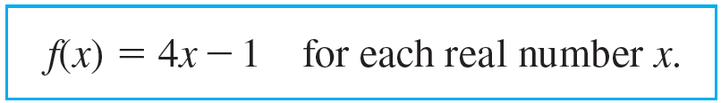
Example 7.2.2 – Solution
continued
a. The function f : R → R is defined by the rule
To prove that f is one-to-one, you need to prove that
∀ real numbers x₁ and x₂, if f (x₁) = f (x₂) then x₁ = x₂.

Slide 19
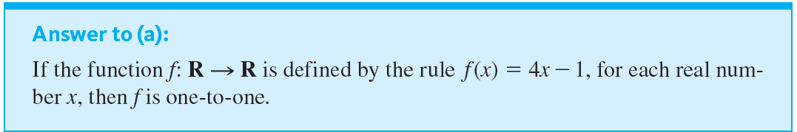
Example 7.2.2 – Solution
continued
Substituting the definition of f into the outline of a direct proof, you
suppose x₁ and x₂ are any real numbers such that 4x₁ − 1 = 4x₂ − 1,
and show that x₁ = x₂.

Slide 20
Example 7.2.2 – Solution
continued
Proof: Suppose x₁ and x₂ are real numbers such that f (x₁) = f (x₂). [We must show that x₁ = x₂.] By definition of f,
4x₁ − 1 = 4x₂ − 1.
Adding 1 to both sides gives
4x₁ = 4x₂,
and dividing both sides by 4 gives
x₁ = x₂,
[as was to be shown].

Slide 21
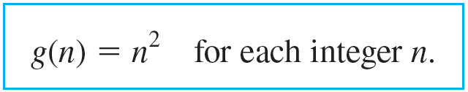

Example 7.2.2 – Solution
continued
b. The function g: Z → Z is defined by the rule
As above, you start as though you were going to prove that g is one-to-one. Substituting the definition of g into the outline of a direct proof, you
suppose n₁ and n₂ are integers such that
and try to show that n₁ = n₂.

Slide 22

Example 7.2.2 – Solution
continued
Can you reach what is to be shown from the supposition? No! It is quite possible for two numbers to have the same squares and yet be different. For example,
but 2 ≠ −2.
Thus, in trying to prove that g is one-to-one, you run into difficulty. But analyzing this difficulty leads to the discovery of a counterexample, which shows that g is not one-to-one.

Slide 23
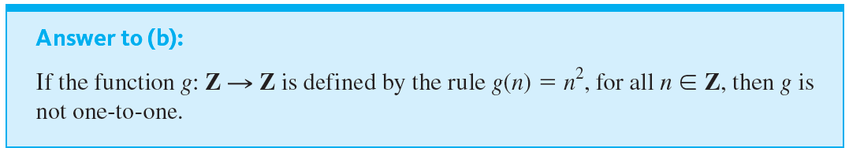

Example 7.2.2 – Solution
continued
This discussion is summarized as follows:
Counterexample:
Let n₁ = 2 and n₂ = −2. Then by definition of g,

Slide 24
Example 7.2.2 – Solution
continued
Hence g(n₁) = g(n₂) but n₁ ≠ n₂,
and so g is not one-to-one.

Slide 25
Application: Hash Functions

Slide 26
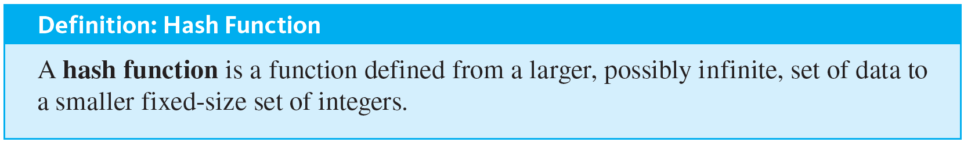
Application: Hash Functions
To make it efficient for the university to store the records, a hash function is needed that (1) is one-to-one and (2) has a co-domain that is very much smaller than one billion. Most hash functions are modifications of mod functions and are defined using prime numbers to increase the chance that their values will be scattered rather than clustered together.

Slide 27
Application: Hash Functions
In addition, making their co-domains 50% to 100% larger than their domains makes it more likely that they will be one-to-one.
Nonetheless, two input values may collide, that is, have the same output value, and various methods are used to avoid such a collision.

Slide 28
Example 7.2.3 – Computing Values of a Hash Function
Instead of 10,000 students, suppose there are only 6. Define a function H, from the set of student ID numbers to the set {0, 1, 2, 3, 4, 5, 6, 7, 8, 9, 10} as follows:
H(n) = n mod 11 for each ID number n.
To compute values of H either use a calculator or a computer with a built-in mod function or use the formula n mod 11 = n − (n div 11).

Slide 29
Example 7.2.3 – Computing Values of a Hash Function
continued
In other words, divide n by 11, multiply the integer part of the result by 11, and subtract that number from n.
As an example, since 328343419 ∕ 11 = 29849401.73.
H(328343419) = 328343419 − (11 · 29849401) = 8

Slide 30
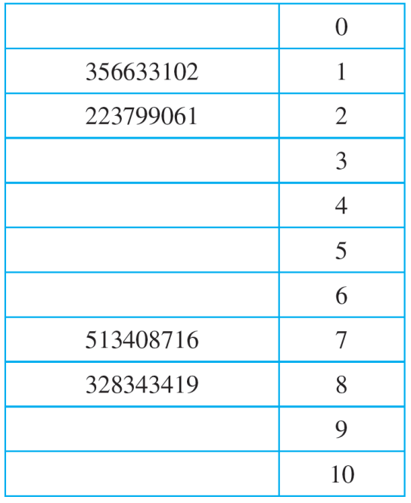
Example 7.2.3 – Computing Values of a Hash Function
continued
To store the link to the record for the student with ID number n, start by computing H(n).
For instance, if the ID numbers are 328343419, 356633102, 223799061, and 513408716, the corresponding H-values are as shown in Table 7.2.1.
Table 7.2.1

Slide 31
Example 7.2.3 – Computing Values of a Hash Function
continued
As noted, H may not be one-to-one: two different ID numbers could have the same H-value.
But because it is important for each value in the table to link to a single student record, a collision resolution method is needed.

Slide 32
Example 7.2.3 – Computing Values of a Hash Function
continued
One of the simplest, called a linear probe, works as follows: If H(n) is already occupied when a new student ID number is input, start from H(n) in the table and search downward to put a link for the student’s record in the first empty position that occurs; if no empty positions remain going down, go up to the beginning of the table and search from there.
Because 11 is greater than 6, empty positions are guaranteed. Suppose the ID number for another student is 607275830. Find the position in the table for this number.

Slide 33
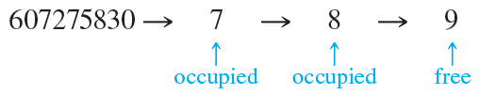
Example 7.2.3 – Solution
When you compute H(607275830) you find that it equals 7, which is already occupied by the link to the record for ID number 513408716. Searching downward from position 7, you find that position 8 is also occupied but position 9 is free.
Therefore, you put the link for the record with ID number 607275830 in position 9.

Slide 34
Application: Hash Functions
A special class of hash functions, known as cryptographic hash functions, is used to secure digital data. A cryptographic hash function is designed to satisfy the following conditions:
1. It is a function from bit strings to bit strings of a fixed length.
2. It is close to being one-to-one: the probability of collisions is very small.

Slide 35
Application: Hash Functions
3. It is close to being a one-way function: given any bit string in its range, finding the inverse image of the string is computationally very difficult.
4. Its values can be quickly computed.
5. A very slight change in an input string results in an extensive change in the output string.
One use of cryptographic hash functions is to provide password security.

Slide 36
Application: Hash Functions
Passwords in a company’s user account file are almost never stored as “clear” text. A basic protection is to apply a cryptographic hash function to the passwords, or to a combination consisting of the passwords plus extra content provided by the company, and to store only the values of the hash function, called the hashes.
To log in, a user keys in a password, which is immediately hashed (meaning that its value is input to the hash function), and the result is compared to the hash stored in the account file.

Slide 37
Application: Hash Functions
In order to complete the login process, the two hashes have to agree.
A somewhat similar kind of hashing is used for checking the integrity of files. When a file is intended to be copied, a cryptographic hash function is applied to it.
The accuracy of a copy is checked by applying the same hash function. If the two hashes agree, the copy is accepted.

Slide 38
Application: Hash Functions
Similarly, when A needs to send a file through a possibly insecure network to B, A can first apply a cryptographic hash function to the file.
Then A sends the hash separately to B through a secure network, and when B receives the file, B applies the same hash function to it that A used.

Slide 39
Application: Hash Functions
B compares the result with the hash received from A, and if the two agree, B can have confidence that the file was unchanged during transmission.
Cryptographic hash functions are also used in blockchain technology. A blockchain is a public register on the Internet made up of linked blocks consisting of records or programs.
To make it impossible to change the data in any part of a block, each includes a time stamp plus a hash computed from all the previous parts of the blockchain.

Slide 40
Application: Hash Functions
To keep the system operating at a reasonable pace and to validate additions, a time-consuming proof of work is required to add a block to the blockchain.
A commonly used proof of work requires a programmer to use repeated random trials, to discover the input that needs to be added to the data in the blockchain so that when the two are hashed together the output will contain a specified number of initial zeroes.

Slide 41
Onto Functions

Slide 42
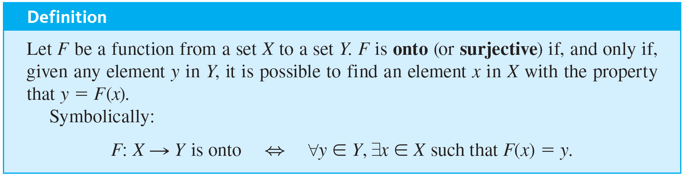
Onto Functions
There may be an element of the co-domain of a function that is not the image of any element in the domain. On the other hand, it is possible for every element in a function’s co-domain to be the image of some element in its domain.
Such a function is called onto or surjective. When a function is onto, its range is equal to its co-domain.

Slide 43
Onto Functions
To obtain a precise statement of what it means for a function not to be onto, take the negation of the definition of onto:
That is, there is some element in Y that is not the image of any element in X.

Slide 44
Onto Functions
In terms of arrow diagrams, a function is onto if each element of the co-domain has an arrow pointing to it from some element of the domain.
A function is not onto if at least one element in its co-domain does not have an arrow pointing to it.

Slide 45
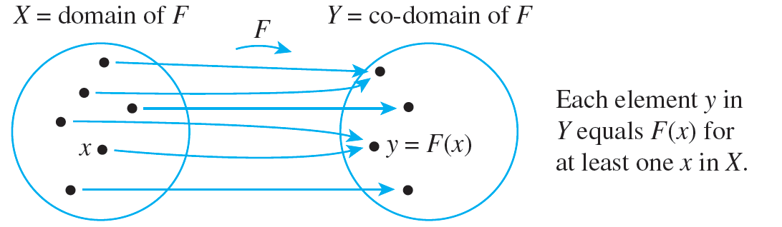
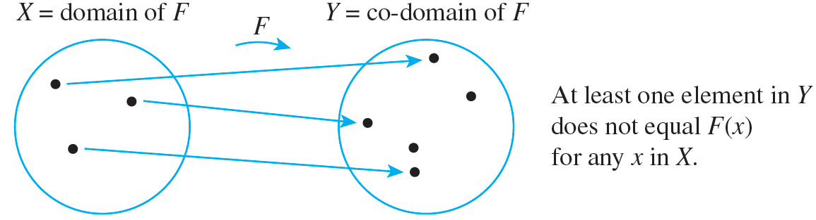
Onto Functions
This is illustrated in Figures 7.2.3(a) and 7.2.3(b).
A Function That Is Onto
Figures 7.2.3(a)
A Function That Is Not Onto
Figures 7.2.3(b)

Slide 46
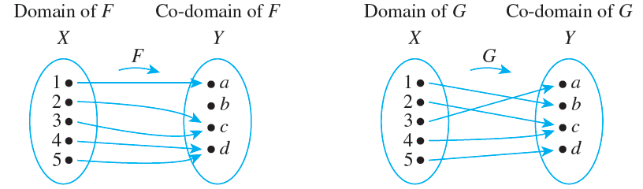
Example 7.2.4 – Identifying Onto Functions Defined on Finite Sets
a. Do either of the arrow diagrams in Figure 7.2.4 define onto functions?
Figures 7.2.4

Slide 47
Example 7.2.4 – Identifying Onto Functions Defined on Finite Sets
continued
b. Let X = {1, 2, 3, 4} and Y = {a, b, c}. Define H : X → Y as follows: H(1) = c, H(2) = a, H(3) = c, H(4) = b.
Define K : X → Y as follows: K(1) = c, K(2) = b, K(3) = b, and K(4) = c. Is either H or K onto?

Slide 48
Example 7.2.4 – Solution
a. F is not onto because b ≠ F(x) for any x in X. G is onto because each element of Y equals G(x) for some x in X : a = G(3), b = G(1), c = G(2) = G(4), and d = G(5).
b. H is onto but K is not. H is onto because each of the three elements of the co-domain of H is the image of some element of the domain of H : a = H(2), b = H(4), and c = H(1) = H(3). K, however, is not onto because a ≠ K(x) for any x in {1, 2, 3, 4}.

Slide 49
Onto Functions on Infinite Sets

Slide 50
Onto Functions on Infinite Sets
Now suppose F is a function from a set X to a set Y, and suppose Y is infinite. By definition, F is onto if, and only if, the following universal statement is true:
∀y ∈ Y, ∃x ∈ X such that F(x) = y.
Thus to prove F is onto, you will ordinarily use the method of generalizing from the generic particular:
suppose that y is any element of Y
and show that there is an element x in X with F(x) = y.

Slide 51
Onto Functions on Infinite Sets
To prove F is not onto, you will usually
find an element y of Y such that y ≠ F(x) for any x in X.

Slide 52
Example 7.2.5 – Proving or Disproving That Functions Are Onto
Define f : R → R and h : Z → Z by the rules
f (x) = 4x − 1 for each x ∈ R
and
h(n) = 4n − 1 for each n ∈ Z.
a. Is f onto? Prove or give a counterexample.
b. Is h onto? Prove or give a counterexample.

Slide 53
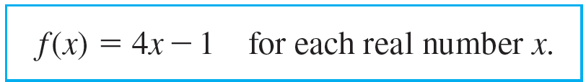
Example 7.2.5 – Solution
a. The best approach is to start trying to prove that f is onto and be alert for difficulties that might indicate that it is not.
Now f : R → R is the function defined by the rule

Slide 54
Example 7.2.5 – Solution
continued
To prove that f is onto, you must prove
∀y ∈ Y, ∃x ∈ X such that f (x) = y.
Substituting the definition of f into the outline of a proof by the method of generalizing from the generic particular, you
suppose y is a real number
and show that there exists a real number x such that y = 4x − 1.

Slide 55
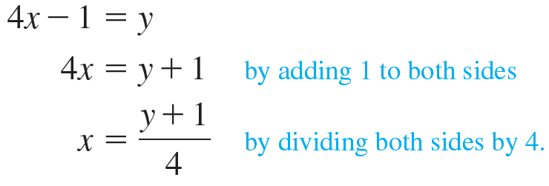
Example 7.2.5 – Solution
continued
Scratch Work: If such a real number x exists, then
Thus if such a number x exists, it must equal (y + 1) ∕ 4. Does such a number exist? Yes.

Slide 56
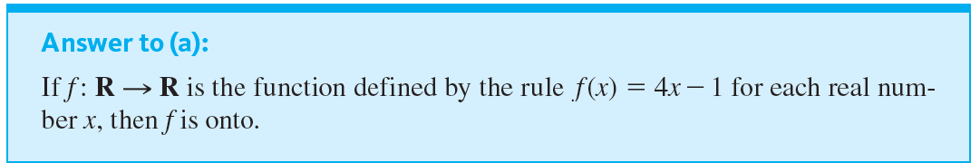
Example 7.2.5 – Solution
continued
To show this, let x = (y + 1) ∕ 4, and then make sure that (1) x is a real number and that (2) f really does send x to y.
The following formal answer summarizes this process.

Slide 57
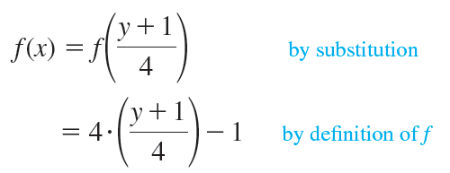
Example 7.2.5 – Solution
continued
Proof: Let y ∈ R. [We must show that ∃x in R such that f (x) = y.] Let x = (y + 1) ∕ 4.
Then x is a real number since sums and quotients (other than by 0) of real numbers are real numbers. It follows that

Slide 58

Example 7.2.5 – Solution
continued
= (y + 1) − 1 = y by basic algebra,
[as was to be shown].
b. The function h : Z → Z is defined by the rule
To prove that h is onto, you must prove that
∀ integer m, ∃ an integer n such that h(n) = m.

Slide 59

Example 7.2.5 – Solution
continued
Substituting the definition of h into the outline of a proof by the method of generalizing from the generic particular shows that you need to
suppose m is any integer
and show that there is an integer n with 4n − 1 = m.
Can you reach what is to be shown from the supposition? No! If 4n − 1 = m,

Slide 60

Example 7.2.5 – Solution
continued
But n must be an integer. And when, for example, m = 0,
which is not an integer.
Thus, in trying to prove that h is onto, you run into difficulty, and this difficulty reveals a counterexample that shows h is not onto.

Slide 61
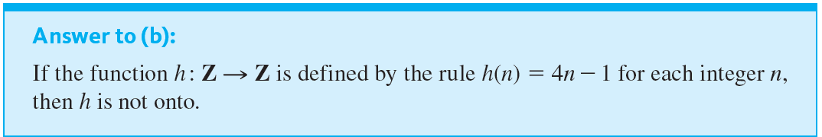
Example 7.2.5 – Solution
continued
This discussion is summarized in the following formal answer.
Counterexample: The co-domain of h is Z and 0 ∈ Z.
But h(n) ≠ 0 for any integer n.

Slide 62

Example 7.2.5 – Solution
continued
For if h(n) = 0, then
4n − 1 = 0 by definition of h
which implies that
4n = 1 by adding 1 to both sides
and so
by dividing both sides by 4.
is not an integer. Hence there is no integer n for which f (n) = 0, and thus f is not onto.
But

Slide 63
Relations between Exponential and Logarithmic Functions

Slide 64

Relations between Exponential and Logarithmic Functions
For positive numbers b ≠ 1, the exponential function with base b, denoted exp _{b}, is the function from R to
defined as follows: For each real number x,
When working with the exponential function, it is useful to recall the laws of exponents from elementary algebra.

Slide 65
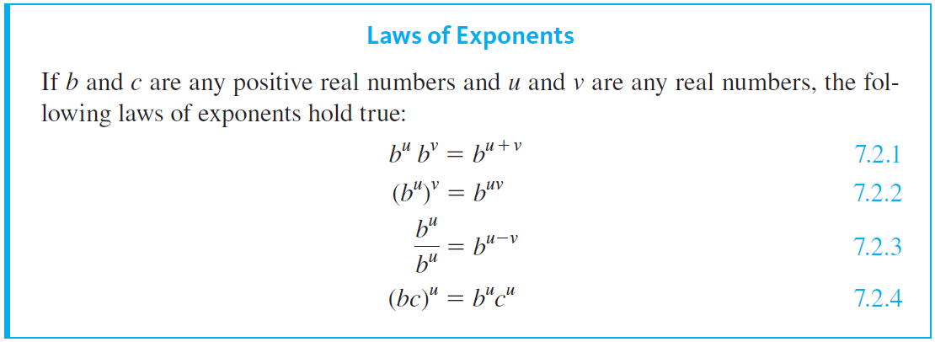
Relations between Exponential and Logarithmic Functions
It can be shown using calculus that both the exponential and logarithmic functions are one-to-one and onto.

Slide 66
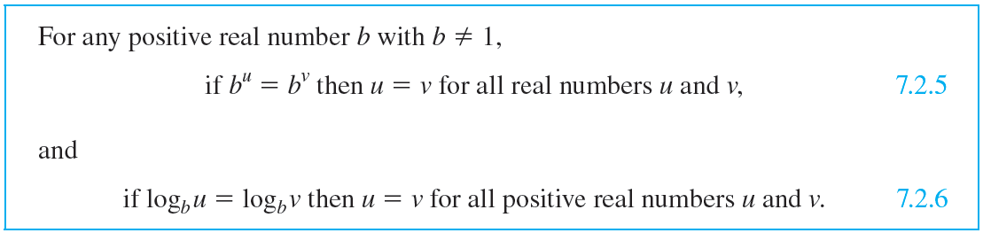
Relations between Exponential and Logarithmic Functions
Therefore, by definition of one-to-one, the following properties hold true:
These properties are used to derive many additional facts about exponents and logarithms.

Slide 67
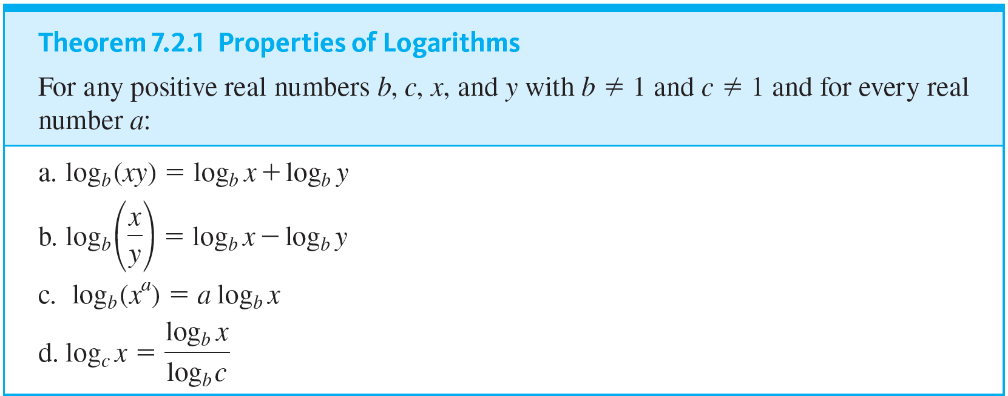
Relations between Exponential and Logarithmic Functions
In particular we have the following properties of logarithms.

Slide 68
Example 7.2.7 – Computing Logarithms with Base 2 on a Calculator
In computer science it is often necessary to compute logarithms with base 2. Most calculators do not have keys to compute logarithms with base 2 but do have keys to compute logarithms with base 10 (called common logarithms and often denoted simply log) and logarithms with base e (called natural logarithms and usually denoted ln).
Suppose your calculator shows that ln 5 ≅ 1.609437912 and ln 2 ≅ 0.6931471806. Use Theorem 7.2.1(d) to find an approximate value for log₂5.

Slide 69

Example 7.2.7 – Solution
By Theorem 7.2.1(d),

Slide 70
One-to-One Correspondences

Slide 71
One-to-One Correspondences
Consider a function F : X → Y that is both one-to-one and onto. Given any element x in X, there is a unique corresponding element y = F(x) in Y (since F is a function).
Also given any element y in Y, there is an element x in X such that F(x) = y (since F is onto) and there is only one such x (since F is one-to-one).
Thus, a function that is one-to-one and onto sets up a pairing between the elements of X and the elements of Y that matches each element of X with exactly one element of Y and each element of Y with exactly one element of X.

Slide 72
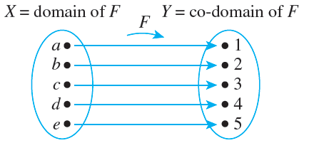
One-to-One Correspondences
Such a pairing is called a one-to-one correspondence or bijection and is illustrated by the arrow diagram in Figure 7.2.5.
An Arrow Diagram for a One-to-One Correspondence
Figures 7.2.5

Slide 73
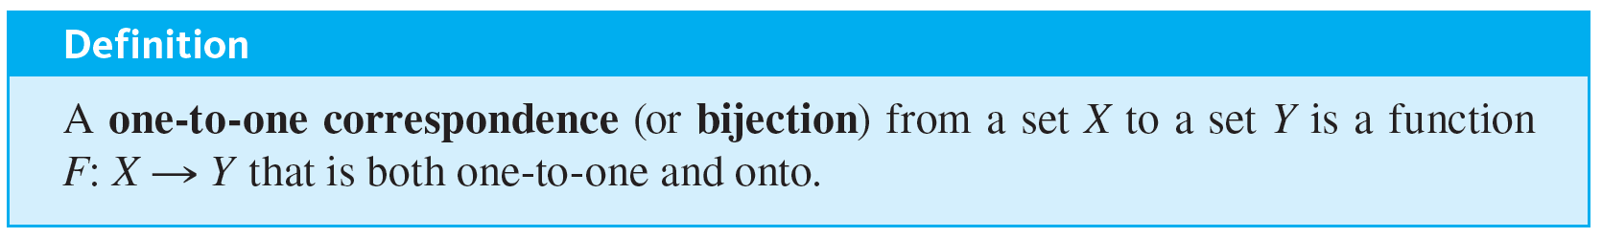
One-to-One Correspondences
One-to-one correspondences are often used as aids to counting. The pairing of Figure 7.2.5, for example, shows that there are five elements in the set X.

Slide 74


Example 7.2.8 – A Function from a Power Set to a Set of Strings
Let
be the set of all subsets of {a, b} and let S be the set of all strings of length 2 made up of 0’s and 1’s. Then
and S = {00, 01, 10, 11}.
Define a function h from
to S as follows: Given any subset A of {a, b}, a is either in A or not in A, and b is either in A or not in A.
If a is in A, write a 1 in the first position of the string h(A); otherwise write a 0 there.

Slide 75
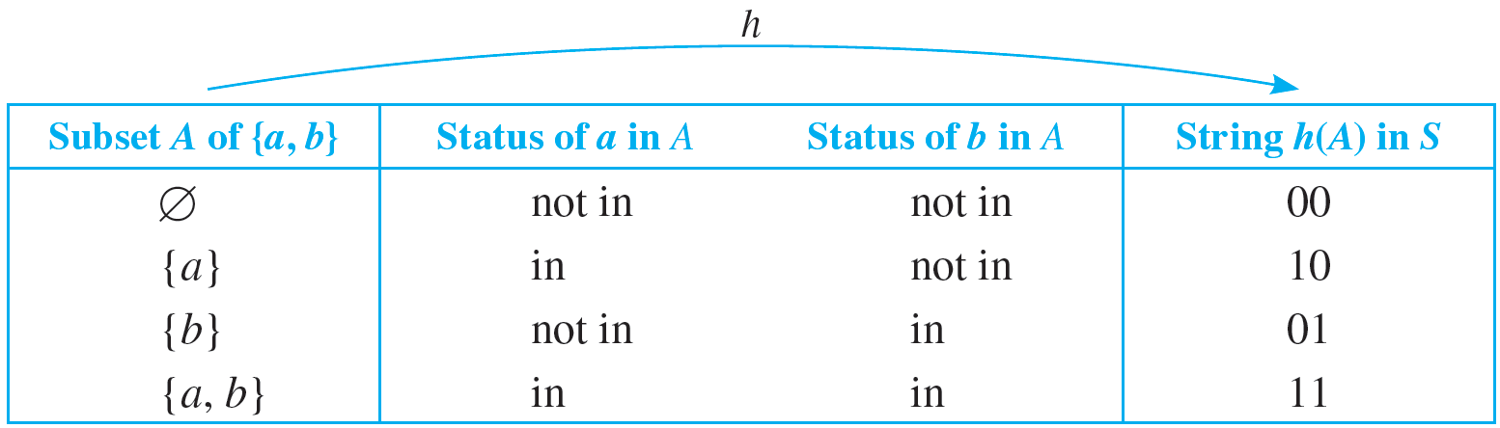
Example 7.2.8 – A Function from a Power Set to a Set of Strings
continued
Similarly, if b is in A, write a 1 in the second position of the string h(A); otherwise write a 0 there. This definition is summarized in the following table.
Is h a one-to-one correspondence?

Slide 76
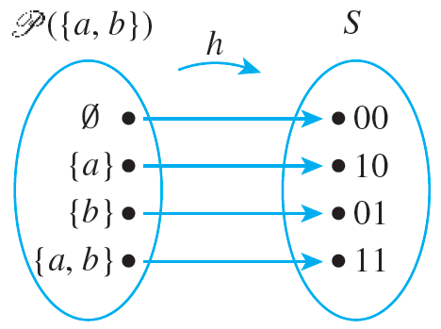
Example 7.2.8 – Solution
The arrow diagram shown in Figure 7.2.6 shows clearly that h is a one-to-one correspondence.
Figures 7.2.6

Slide 77
Example 7.2.8 – Solution
continued
It is onto because each element of S has an arrow pointing to it.
It is one-to-one because each element of S has no more than one arrow pointing to it.

Slide 78
Inverse Functions

Slide 79
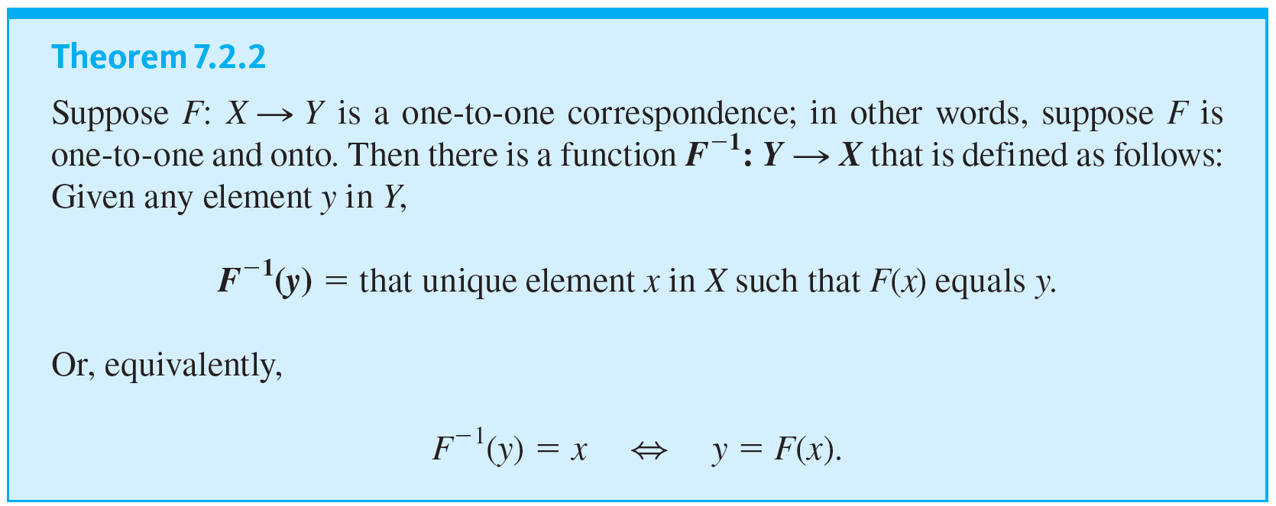
Inverse Functions
If F is a one-to-one correspondence from a set X to a set Y, then there is a function from Y to X that “undoes” the action of F; that is, it sends each element of Y back to the element of X that it came from. This function is called the inverse function for F.

Slide 80
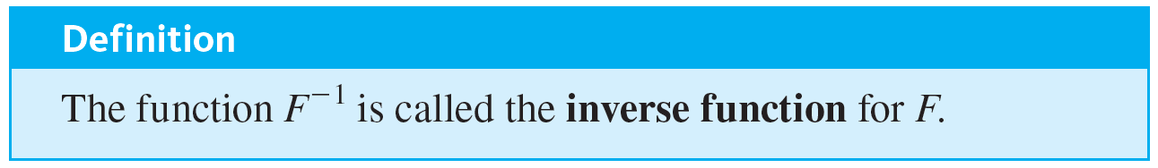
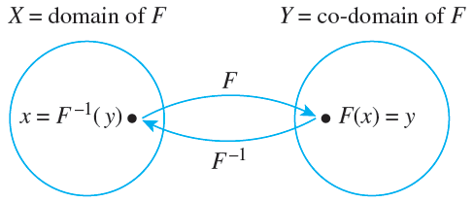
Inverse Functions
Note that according to this definition, the logarithmic function with base b > 0 and b ≠ 1 is the inverse of the exponential function with base b. The diagram that follows illustrates the fact that an inverse function sends each element back to where it came from.

Slide 81
Example 7.2.11 – Finding an Inverse Function for a Function Given by an Arrow Diagram
Define the inverse function for the one-to-one correspondence h given in Example 7.2.8.

Slide 82


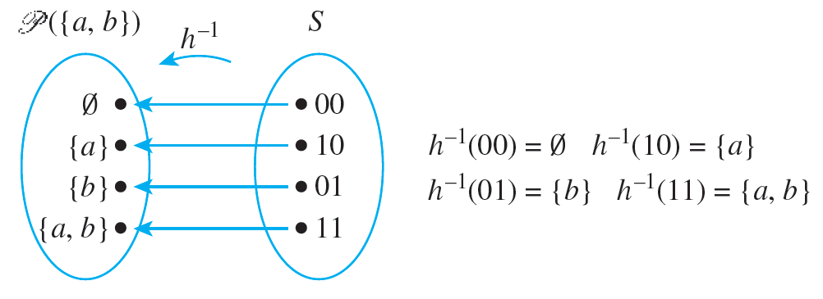
Example 7.2.11 – Solution
The arrow diagram for
is obtained by tracing the h-arrows back from S to
as shown below.

Slide 83
Example 7.2.12 – Finding an Inverse Function for a Function Given in Words
Define the inverse function for the one-to-one correspondence g given below:
g : T → T

Slide 84

Example 7.2.12 – Solution
The function g : T → T is defined by the following rule:
For all strings t in T,
g(t) = the string obtained by writing the characters of t in reverse order.
Now if the characters of t are written in reverse order and then written in reverse order again, the original string is recovered. Thus given any string t in T,

Slide 85


Example 7.2.12 – Solution
continued
= the string obtained by writing the characters of t in reverse order
= g(t).
Hence
is the same as g, or, in other words,

Slide 86
Example 7.2.13 – Finding an Inverse Function for a Function Given by a Formula
The function f : R → R defined by the formula
f (x) = 4x − 1 for each real number x
was shown to be one-to-one in Example 7.2.2 and onto in Example 7.2.5. Find its inverse function.

Slide 87



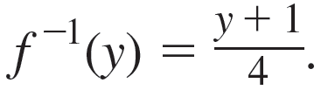
Example 7.2.13 – Solution
For any [particular but arbitrarily chosen] y in R, by definition of
= that unique real number x such that f (x) = y.
But f (x) = y
⇔ 4x − 1 = y by definition of f
Hence

Slide 88
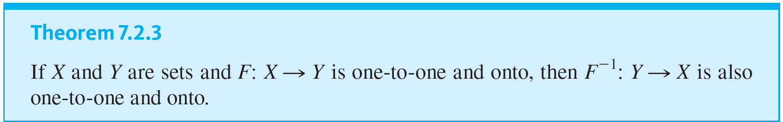
Inverse Functions

Slide 89


Example 7.2.14 – Finding an Inverse Function for a Function of Two Variables
Define the inverse function
for the one-to-one correspondence given below:

Slide 90




Example 7.2.14 – Solution
We know that
Because F is one-to-one, this means that
is the unique ordered pair in the domain of F that is sent to (u, v) by F.
Thus,
is defined as follows: For each ordered pair (u, v) ∈ R × R,

